Slide 1
Boosting Student Achievement
Through Formative Coaching

Slide 2
Agenda
Why coach teachers?
What is digiCOACH?
How does digiCOACH work?
Practice using digiCOACH
Review digiCOACH report examples

Slide 3

Why Feedback is SO Important
Improving the academic growth and
social/emotional wellness of our students.
Notes:
(Focusing on the process and not the system…)
We are believers in the coaching process and know that it is key to improving our students academic and social/emotional wellness. That’s why we do it.
If there is one thing to take away from the training today, it’s the power of coaching.

Slide 4

Feedback is Powerful
Improves Quality of Teaching
Improves Student Learning
Springboard to Collective Action
“We is smarter than me”
Bloomberg & Pitchford; 2017
Leading Impact Teams: Building a Culture of Efficacy

Slide 5
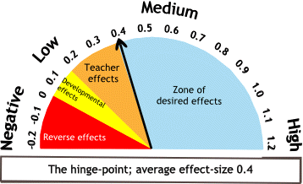
High Yield Strategies
0.4 = 1 year of academic growth. 0.8 = 2 years of growth
Classroom
Strategies
Site-Level
Strategies
0.72
Teacher-Student Relationships – Interactions among teachers and students are positive and demonstrate respect.
0.72
Maximize feedback to teachers about their impact
0.72
Building trust and welcoming errors as opportunities to learn
0.82
Classroom Discussion - Students engage in structured interaction around the learning
0.93
Teachers working together as evaluators of their impact
1.57
Collective Teacher Efficacy - the collective belief of teachers in their ability to positively affect students.
Visible Learning John Hattie, 2008

Slide 6
Collective Teacher Efficacy
Student
Academic
Growth
=
Notes:
And the research tells us that collective teacher efficacy will result in growth at our campus.

Slide 7
Focused Walkthroughs
Professional Development
Observational & Coaching Data
Collective Teacher Efficacy
Collaborative Communities/PLC
Notes:
Each of these elements play a key role in developing both individual and collective teacher efficacy.

Slide 8

Focused Walkthroughs
Professional Development
Observational & Coaching Data
Collaborative Communities

Slide 9
What is digiCOACH?

Slide 10
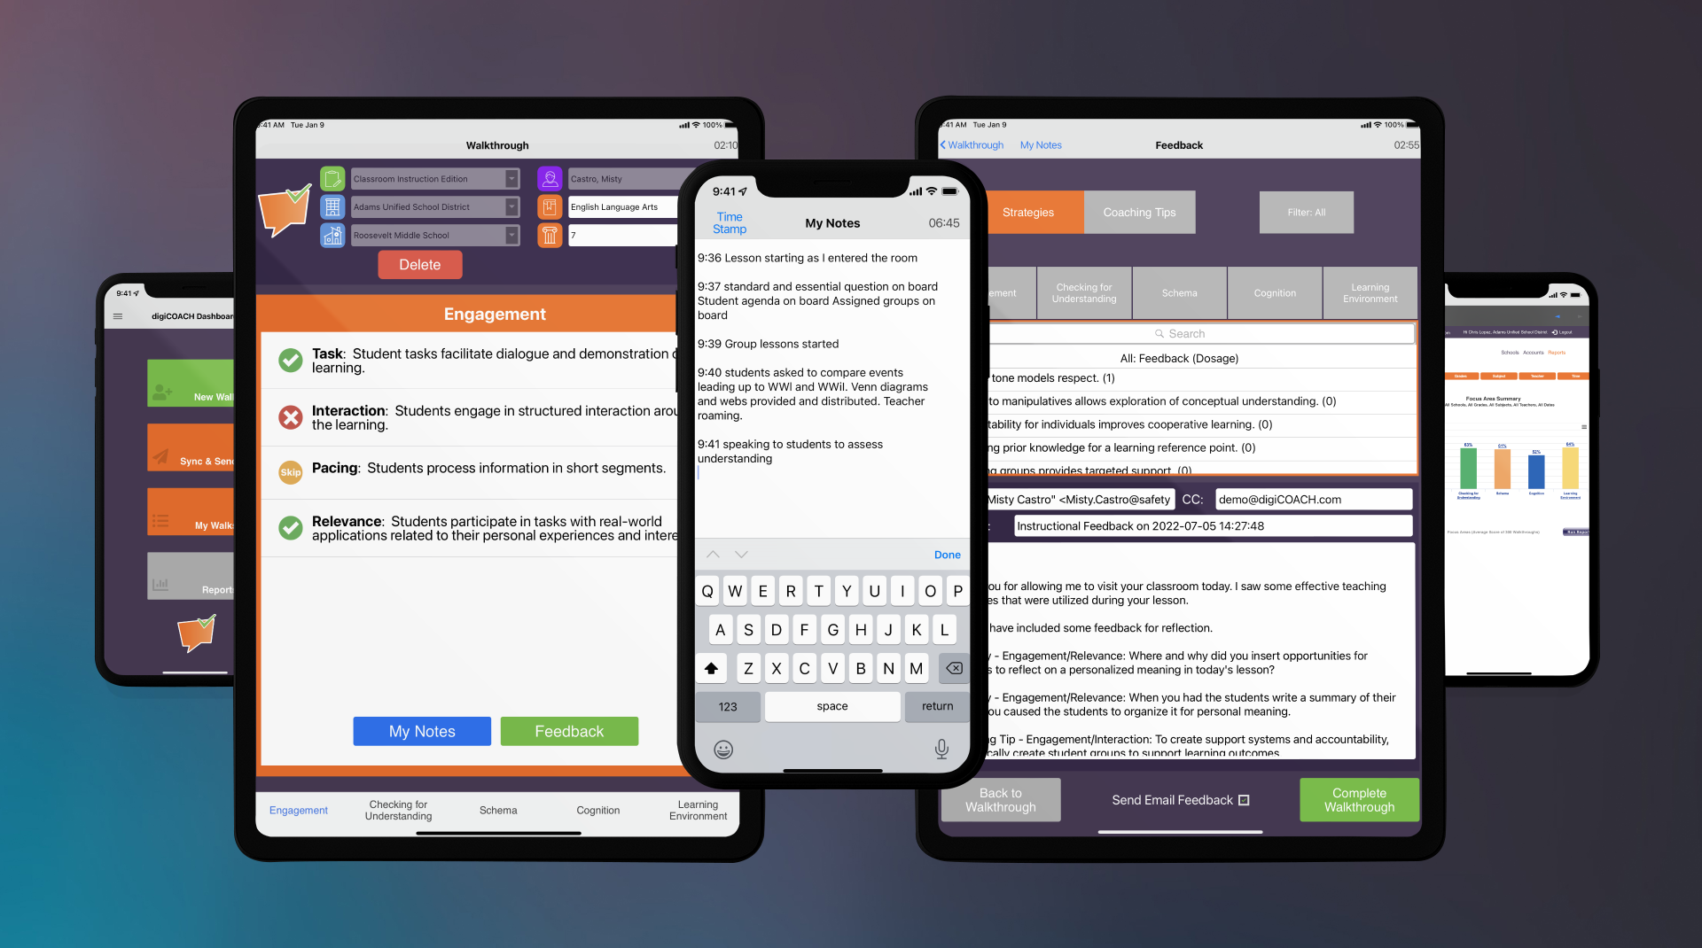
Walkthrough Support • Formative Coaching • Cloud Reporting
Notes:
These are the three parts to the digiCOACH classroom walkthrough system.
Walkthrough tool allows for quick data collection which powers the reports.
Formative coaching system that allows for quick and meaningful feedback.
Cloud Reports that can inform the professional development needs.

Slide 11
Formative Coaching with digiCOACH
Supports informal classroom visits.
Guides the coach through five focus areas.
Provides immediate feedback by email in the form of research based instructional commendations and coaching tips.
Include personalized feedback from the coach.
Notes:
digiCOACH addresses these areas.

Slide 12

Walkthrough Highlights
5 minutes
-Snapshot-
Notes:
Walkthrough
A moment in instructional time
Focus is on the instructional management and delivery
Evidence
Instructional strategies that promote student learning
Instructional strategies that are witnessed within the designated time

Slide 13
Longitudinal Walkthrough Data
5 minutes
5 minutes
5 minutes
5 minutes
5 minutes
5 minutes
5 minutes
5 minutes
5 minutes
5 minutes
-Snapshots Over Time-
Notes:
Walkthrough
A moment in instructional time
Evidence
Instructional strategies that promote student learning
Longitudinal
Established time frames
Focus areas have reasonable data collection to identify consistent patterns over time

Slide 14
What digiCOACH is not…

Slide 15
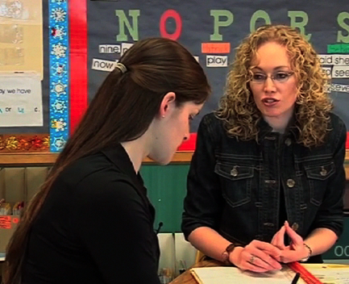
Evaluating
Coaching
Notes:
digiCOACH was created by educators. This tool is designed to identify effective instructional patterns over a period of time. The data results are used to analyze professional development focus areas.
digiCOACH established five researched based focus areas, and categorized foundational components into sub-criteria.
digiCOACH facilitates the frequency and the quality of teacher feedback. The feedback is intended to elicit dialogue and highlight student learning.

Slide 16
How does digiCOACH Work?

Slide 17
If using a custom digiCOACH edition, insert it here.
If using a prebuilt edition, unhide the relevant slide(s) following this slide.
Alternatively, visit digiCOACH.com/editions.html to access a library of prebuilt editions.

Slide 18
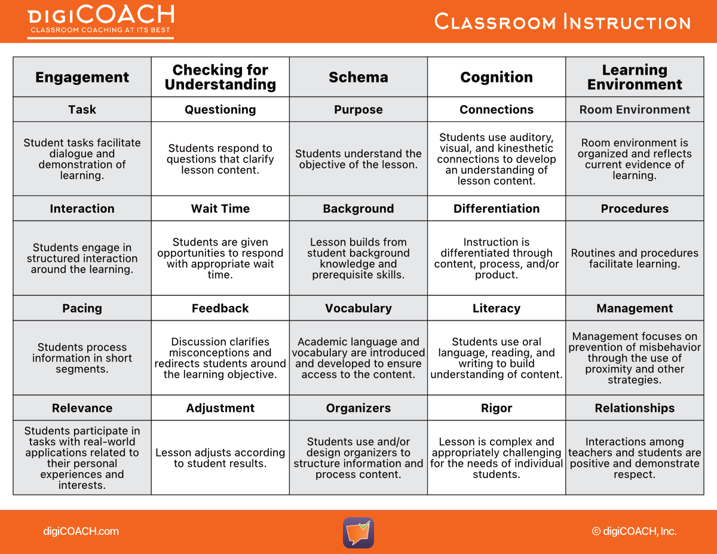

Slide 19
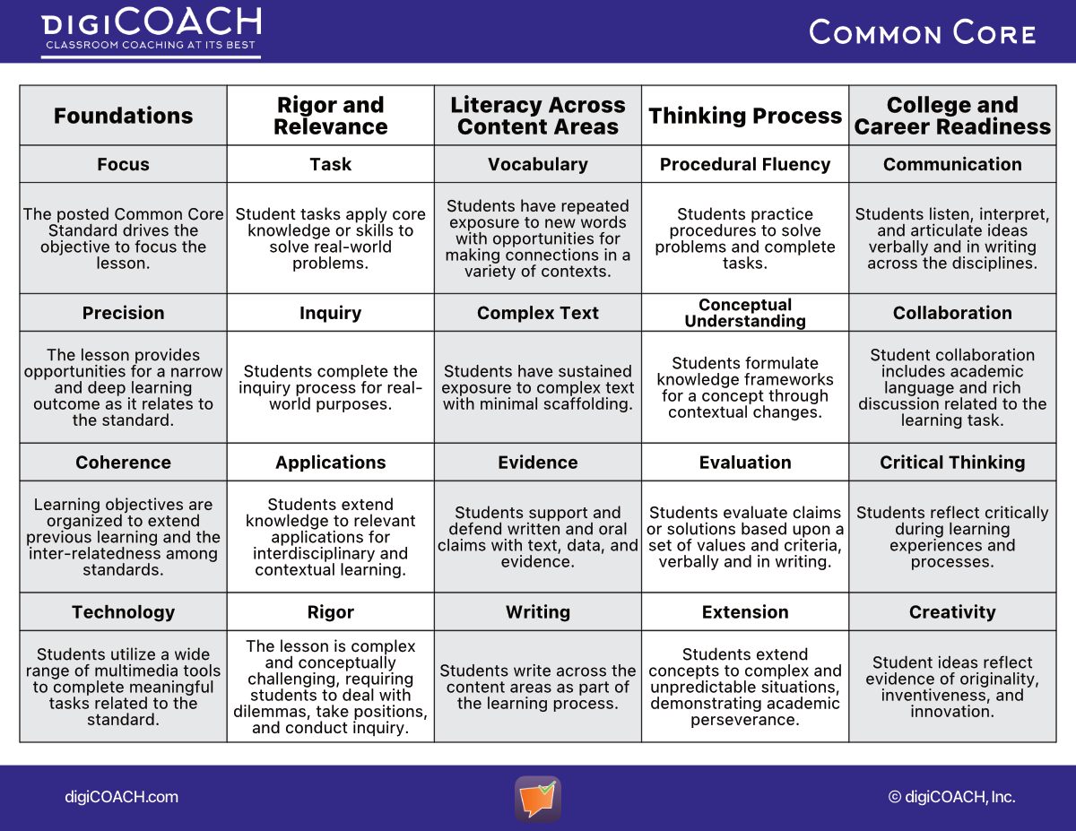

Slide 20
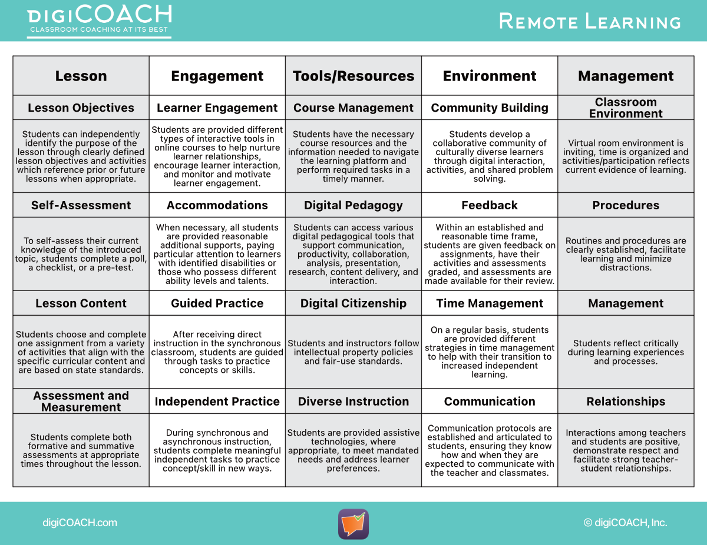

Slide 21
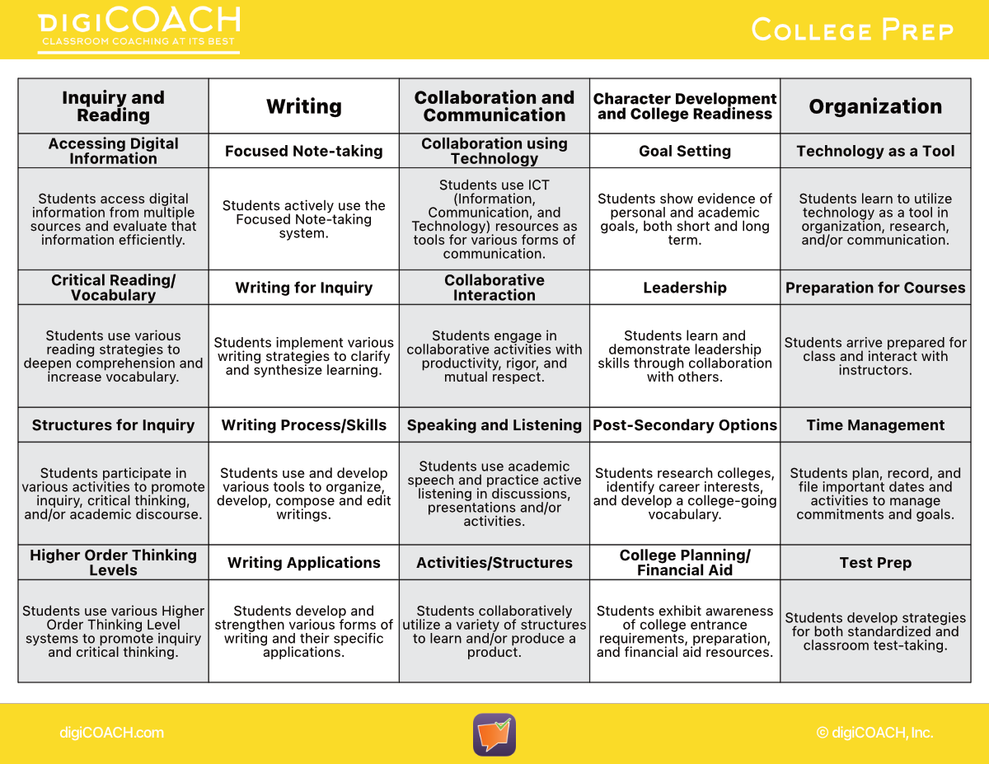

Slide 22
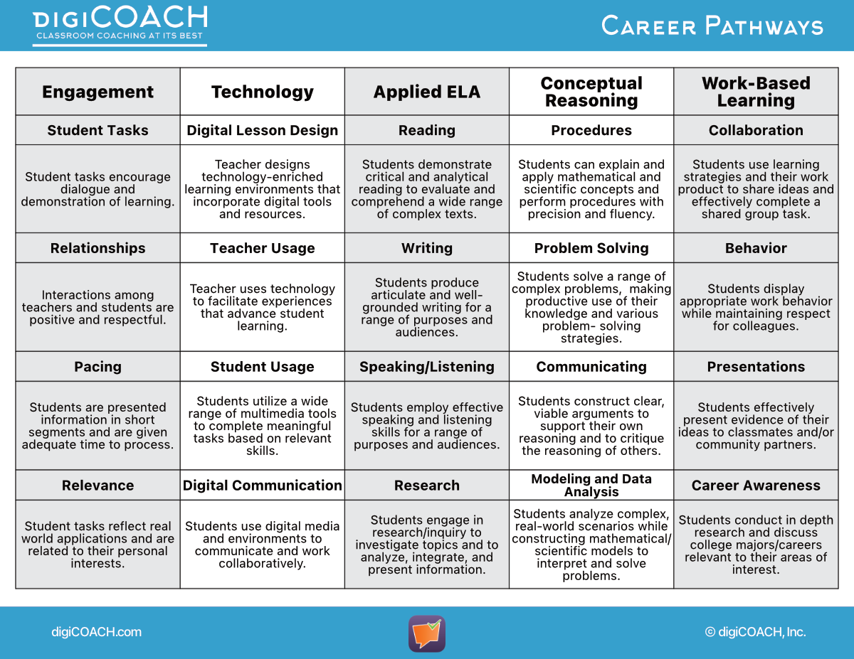

Slide 23
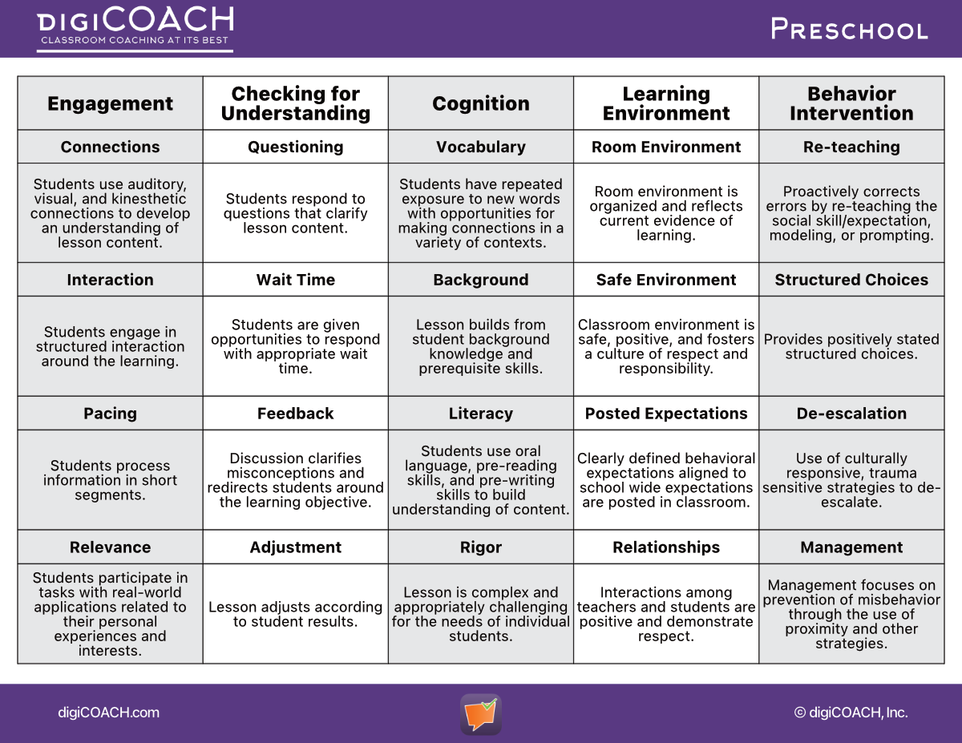

Slide 24
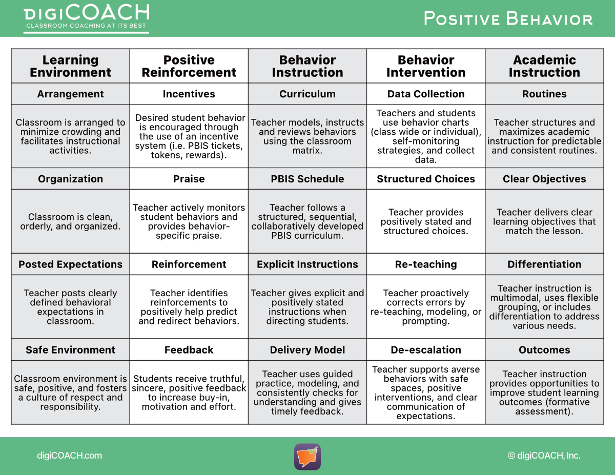

Slide 25

Communication is the Key!
Reflections, strategies, and
other feedback sent via email.
Notes:
Communication is the Key
Teachers receive feedback immediately by email.
This feedback focuses on instructional evidence.

Slide 26

Walkthrough Highlights Emailed
@
5 minutes
-Snapshot-
Notes:
Reminder…
Walkthrough
A moment in instructional time
Focus is on the instructional management and delivery
Evidence
Instructional strategies that promote student learning
Instructional strategies that are witnessed within the designated time

Slide 27
Types of Feedback
Strategies
Coaching Tips
Reflective Qs
Highlighting Strengths & Evidence
Offering Support & Suggestions
Ideas & Concepts to Consider
Notes:
Types of Feedback
Strategies
Evidence of instructional strengths
Evidence of student learning
Coaching Tips
Support and enrich instructional practices
Create an opportunity for dialogue and professional collaboration that will adjust results

Slide 28
Example Email Feedback
On Mon, August 10, 2022 at 11:05 AM, digiCOACH <steve@digicoach.com> wrote:
Debbie,
Thank you for allowing me to observe your instruction today. I saw many effective teaching strategies that were utilized during your lesson.
I have included some of the positive strategies that I observed, as well as coaching tips for use in future lessons.
Strategy - Checking for Understanding/Questioning: Your probing questions helped you to assess students’ understanding of key concepts.
Strategy - Engagement/Pacing: By teaching the lesson in small segments, you kept the students
engaged and on-task.
Strategy - Learning Environment/Interactions: Your positive feeling tone with the students
encouraged the students to show respect to their classmates.
Coaching Tip - Checking for Understanding/Adjustment: Using students’ feedback to clarify misconceptions
makes the learning more effective.
Regards,
Steve Hamilton
@
Auto Generated Text
Strategy/Strengths
Selected by Coach
Coaching Tip/Support
Selected by Coach
Notes:
Feedback Email
Auto Generated Text (pink)
The outlined greeting is embedded into all e-mails.
Strategy (yellow)
Throughout the body of the e-mail you will find feedback that was selected by the administrator or coach.
The feedback reflects evidence of the instructional strategies witnessed during the isolated walkthrough.
Coaching Tip (blue)
Throughout the body of the e-mail you will find a Coaching Tip that can enhance student learning.
The feedback is selected by the administrator or coach.

Slide 29
Let’s do a virtual walkthrough!
Suggested Video Resources
www.youtube.com
Keywords: Whole Brain Teaching: High School Math
www.vimeo.com
Keywords: Integrating WITS LEADS in the classroom- A
Grade 4 Language Arts Lesson
Suggestion:
Concentrate on one Focus Area until calibration and common meaning occur.
Notes:
Suggested Resources for Calibration
Edition Handout
This handout provides an opportunity for teachers to participate in a virtual walkthrough. The worksheet displays each Focus Area and the correlated look-fors.
Calibration
This is a great opportunity to calibrate the meaning of each sub-criteria, and dialogue the types of evidence.
Suggestion
Concentrate on one Focus Area until calibration and common meaning occur.

Slide 30
What can digiCOACH Reports Show

Slide 31
Longitudinal Walkthrough Artifacts
5 minutes
5 minutes
5 minutes
5 minutes
5 minutes
5 minutes
5 minutes
5 minutes
5 minutes
5 minutes
-Snapshots Over Time-
Notes:
Reminder
Walkthrough
A moment in instructional time
Evidence
Instructional strategies that promote student learning
Longitudinal
Established time frames
Focus areas have reasonable data collection to identify consistent patterns over time

Slide 32
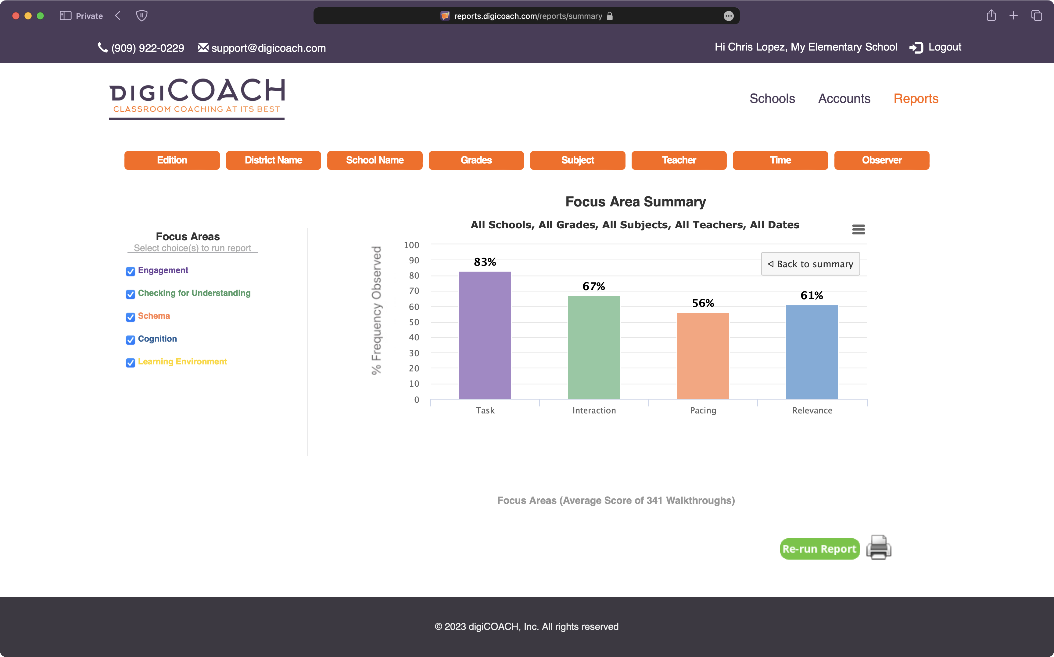
What are this school’s strengths?
In which areas would professional development be most beneficial for this site?
What additional information would be beneficial?
Notes:
Look-for Summary Report – Allows for a more focused look at one specific Focus Area which allows for you to see the individual Look-fors within that area.

Slide 33
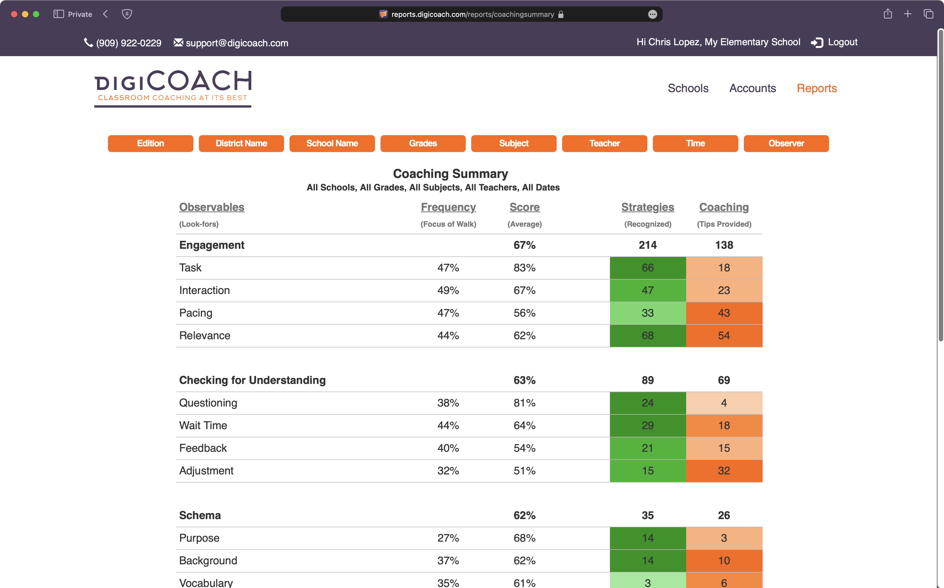
What are this school’s strengths?
Which look-fors have been supported through strategies most?
What additional information would be beneficial?
Notes:
Coaching Summary Report – Allows you to see the average score for each look-for and compare the areas that you are praising (Strategies) and where you are offering suggestions (Coaching Tips)

Slide 34
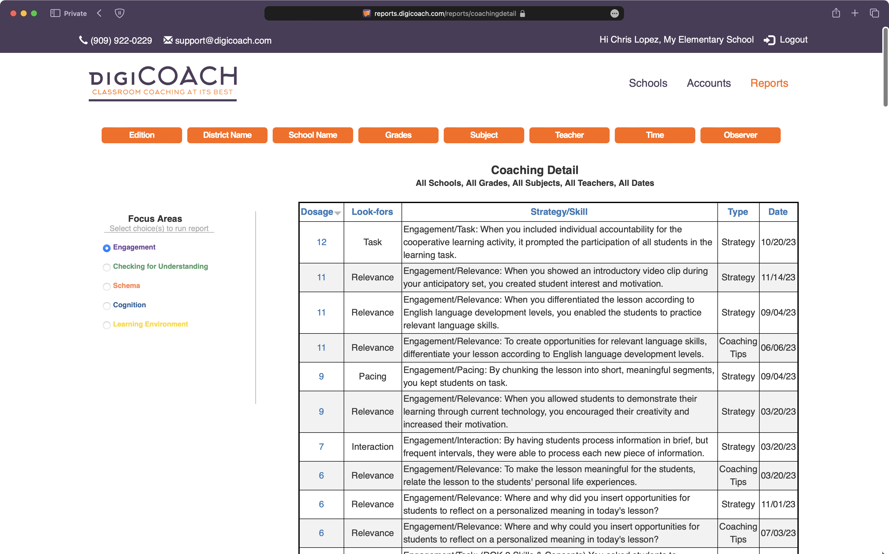
What are this school’s strengths?
How can coaching tips support teacher PLC activities?
What additional information would be beneficial?
Notes:
Coaching Detail Report – Identifies which Strategies and Coaching Tips have been utilized across the campus, summarizing the different feedback sent to all staff members.

